Slide 1
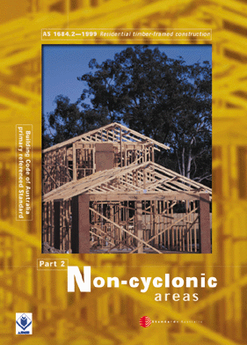
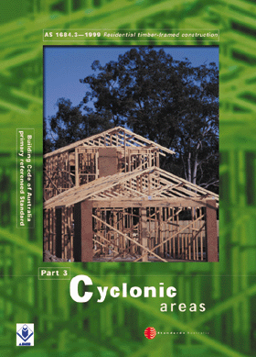
SECTION 3 -
SUBSTRUCTURE

Slide 2
3.1 SCOPE
This Section sets out requirements for site preparation, subfloor supports and the determination of footing sizes suitable for supporting timber-framed houses. This Section is derived from AS 2870.1 using allowable soil bearing stresses.

Slide 3
3.2 SITE PREPARATION
AND DRAINAGE
The clearing and drainage of the site on which the building is to be erected shall be adequate to ensure protection of any timber framing or components from the effects of prolonged dampness or insect attack

Slide 4
3.2.2 Site clearing
The site shall be cleared of any logs, tree roots or stumps and other wood debris, including waste material from the construction, likely to increase the termite risk or cause damage to footings or concrete slabs or subsoil drainage, within and around the building.

Slide 5
3.2.2 Site drainage
Surface and subsurface water occurring on the building site shall be diverted to prevent it from flowing under the structure. Ponding of water under the structure shall be prevented by filling, grading or the provision of drainage or diversion channels.
NOTE: The ground surface should be graded to fall away from the building.

Slide 6
3.3 GROUND CLEARANCES AND SUBFLOOR VENTILATION
Ground clearance and subfloor ventilation shall be provided in accordance with the provisions of the Building Code of Australia.

Slide 7
The BCA, section 3.4 outlines sub-floor ventilation requirements to limit the moisture content of framing timbers in the sub-floor space. The minimum level of ventilation required to achieve this is dependent on the location and sub-floor conditions.

Slide 8
The levels outlined in the BCA are primarily to limit the moisture content of sub-floor framing timbers, which can generally tolerate greater fluctuations in moisture content, than timber floors.
Timber T & G feature floors should be provided with a minimum sub-floor ventilation that exceeds these BCA requirements.
The recommended minimum level will be dependent on location and state timber associations should be consulted for advice.

Slide 9
3.4 DURABILITY
3.4.1 Termite management
Protection against termites shall be provided in accordance with the provisions of the Building Code of Australia.

Slide 10
3.4.2 Species selection
Any species and durability classes of timber may be utilized for floor and subfloor framing where adequate ventilation and weather protection is provided (see also Clause 1.10).
NOTE: For extremely damp or unventilated situations or timber in contact with the ground (see Appendix C).

Slide 11
3.5 SUBSTRUCTURE BRACING
The substructure shall be adequately braced against all of the applied loads (see Section 8).

Slide 12
3.6 SUB-FLOOR SUPPORTS
3.6.1 General
Stumps, posts, piers, and the like, positioned beneath the floor shall be designed to support vertical gravity loads.
This Clause provides a procedure to determine typical vertical gravity loads and the capacity and size of some footings.
Alternatively, for wind classifications N1 and N2, footings, stump and post sizes may be determined from Clause 3.7 .

Slide 13
3.6.2 Soil classification
Details provided in this Clause are only applicable to A, S, M or H soil classification with a minimum allowable bearing capacity of 100 kPa.
Soil classifications E and P are beyond the scope of this Section and further professional advice is required.

Slide 14
3.6.2 Soil classification (cont’d)
Where the allowable bearing capacity of the soil has been determined from site investigation, then this capacity shall be used to determine the footing size in accordance with Clause 3.6.6.
Site soil classifications shall be made in accordance with AS 2870.1.

Slide 15
3.6.3 Procedure
(a) Determine the individual dead and live loads that contribute to the total vertical gravity load combination
(b) Calculate the total vertical gravity load from the load combination given in Clause 3.6.5.
(c) Determine the size of the footing, or bearing area required, for piers, stumps, posts, and the like

Slide 16
3.6.4 Determination of vertical gravity loads
3.6.4.2 Permanent (dead) loads (G)
(a) Floor loads The total floor loads (kN) shall be calculated by multiplying the floor area (m²) supported by the individual stump, pier, post, or the like, under consideration by the unit mass of the floor system (kN/m²)

Slide 17
  (a) Floor loads (cont)
  If supported floor areas have different masses, the contribution of individual areas shall be summed to determine the total load. Where items such as water beds, slate-based billiard tables, spas, hot tubs and other permanent loads are not included in the typical masses given in Table 3.1 and, where present, the mass of these shall be added to the total.

Slide 18
  (a) Floor loads (cont)
  Ceilings on the underside of floor joist are assumed to be either 13 mm plasterboard, or material of similar mass (12 kg/m²).
  Table 3.1 provides guidance for the mass of typical floor systems. The mass of quarry or slate tiles and bedding compound are not covered by this Table.

Slide 19
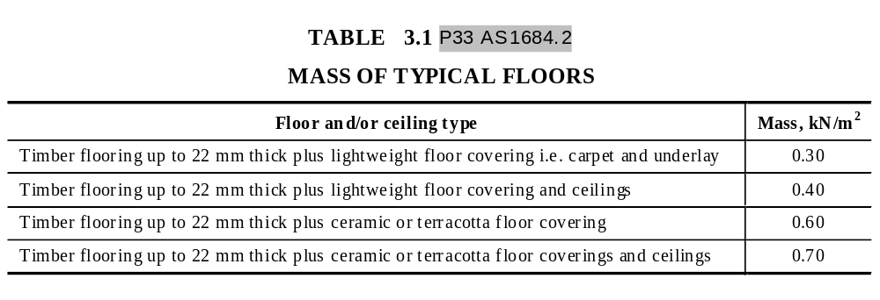
  (a) Floor loads (cont)

Slide 20
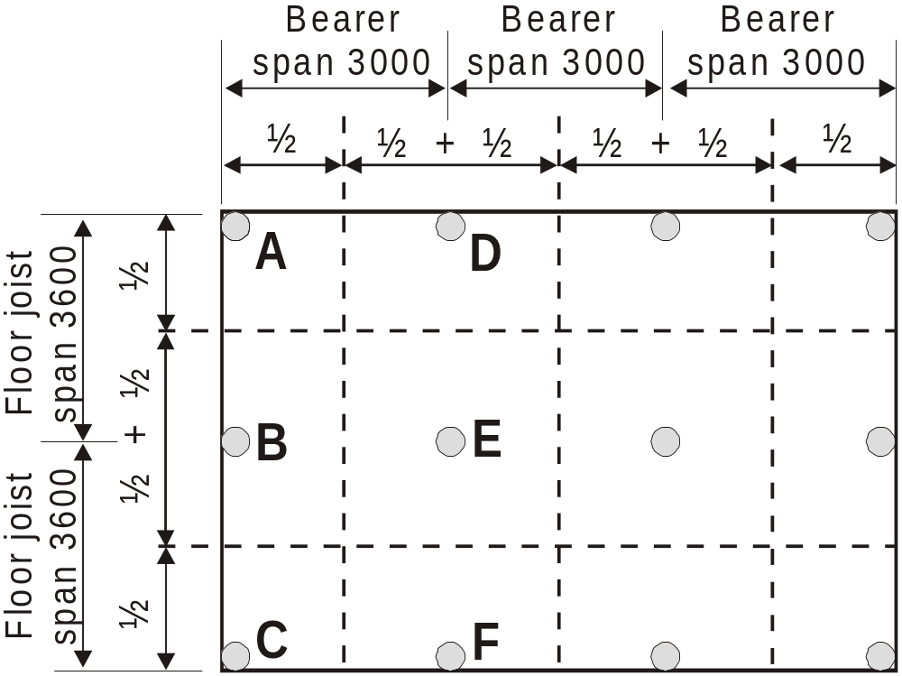
EXAMPLE - FLOOR LOADS :
Calculate floor areas supported by each post as per 2.6.5 Area supported.
Area supported by post at
A = 1.5m x 1.8m = 2.7m²
B = 1.5m x 3.6m = 5.4m²
D = 3.0m x 1.8m = 5.4m²
E = 3.0m x 3.6m = 10.8m²

Slide 21
EXAMPLE - FLOOR LOADS :
Assuming a timber floor with light weight covering - .3 kN/m² , then the floor load on the post at
A = 2.7 x .3 = 0.81kN
B = 5.4 x .3 = 1.62kN
D = 5.4 x .3 = 1.62kN
E = 10.8 x .3 = 3.24kN

Slide 22
(b) Wall loads
The total wall load (kN) shall be determined by multiplying the floor area (m²) supported by the individual stump, pier, post, or the like, under consideration by 0.4 kN/m².
NOTE: The value of 0.4 kN/m² applied to the floor area has been determined as a typical distributed wall load averaged over the floor area for most housing.

Slide 23
(b) Wall loads
For two-storey construction, the floor area of both upper and lower storey shall be included in the floor area determination. Where the actual permanent wall load (kN) applied to individual footings has been calculated, this load shall be used.

Slide 24
EXAMPLE - WALL LOADS :
Using the areas supported as calculated for floor loads, the wall loads on the posts will be:
A = 2.7 x .4 = 1.08kN
B = 5.4 x .4 = 2.16kN
D = 5.4 x .4 = 2.16kN
E = 10.8 x .4 = 4.32kN

Slide 25
(c) Roof loads
The total roof load (kN) shall be determined by multiplying the roof area (m²) supported by the individual stump, pier, post or the like, under consideration by 0.4 kN/m² for sheet roofs, and 0.9 kN/m² for tile roofs.

Slide 26
(c) Roof loads (cont)
  NOTES:
  1 The values of 0.4 kN/m² and 0.9 kN/m² have been determined as typical average unit masses for total roof masses for sheet and tile roofs respectively.
  2 Care should be taken when determining the contributory roof area and respective load paths applied to each footing under consideration.

Slide 27
Note 2 is alerting us to the fact that different roof configurations distribute the roof loads to the foundations differently for example:
A pitched roof with underpurlins will distribute the load between external walls and internal walls and there may also be concentrations of load at the ends of strutting beams etc.
However a standard trussed roof distributes all of the roof load to the external walls however there may be concentrations of load where girder trusses are located.

Slide 28
The Roof Load Widths (RLW) in the following examples have been calculated based on a building width of 7200 mm, a roof pitch of 20^{O} and an overhang of 600 mm.

Slide 29
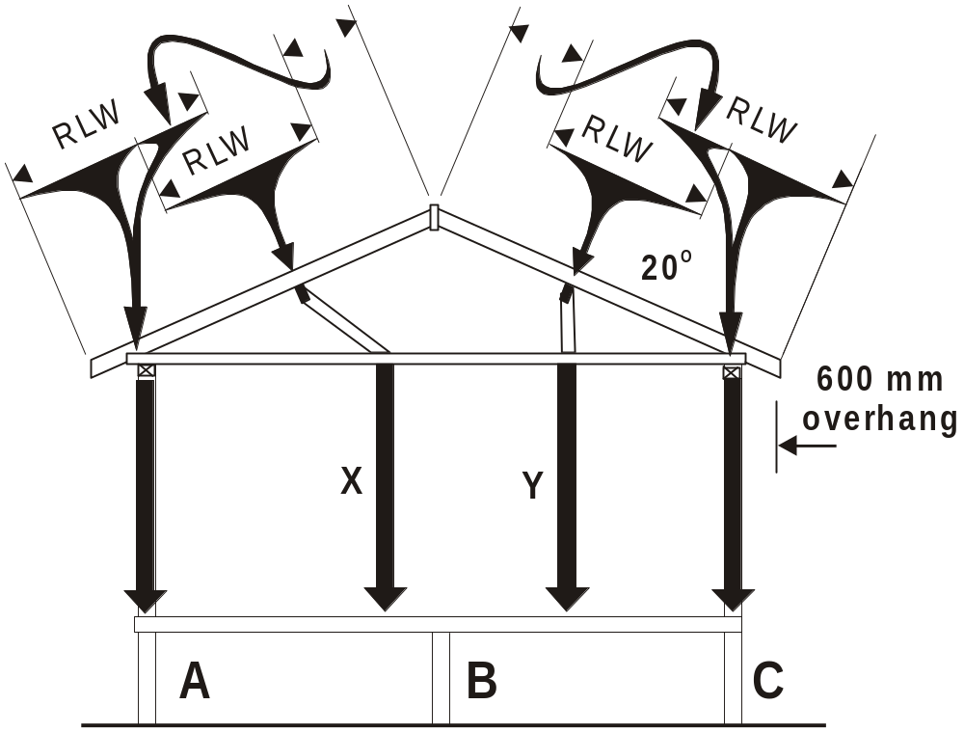
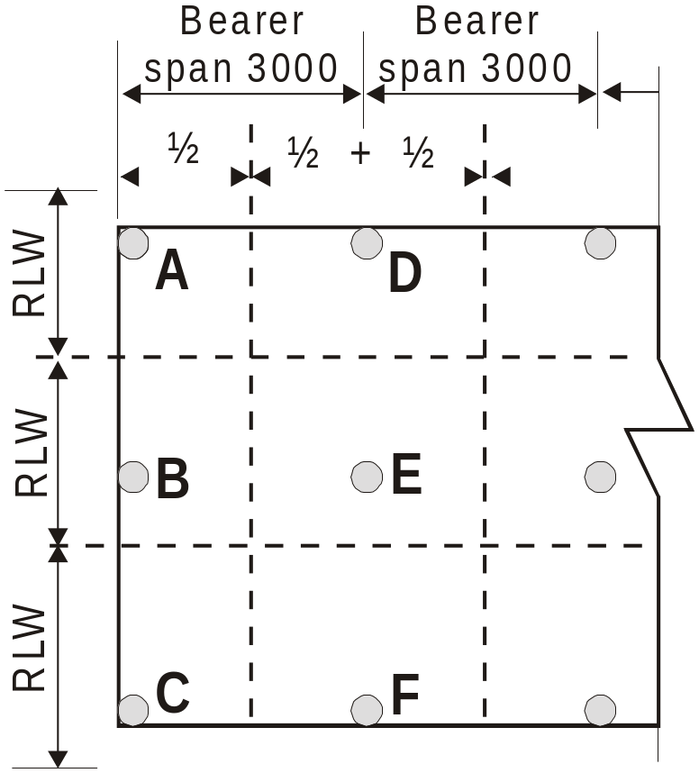
Pitched Roof - assuming no point loads from strutting beams etc. and that roof loads on wall X will be taken by post at B and roof loads on wall Y will be evenly distributed between posts at B and C ..............

Slide 30
.....Roof load at
A = 2.55(RLW) x 1.5 = 3.83m² x 0.9 (tile roof) = 3.44kN
B = 2.88(RLW) x 1.5 = 4.32m² x 0.9 (tile roof) = 3.89kN
C = 3.51(RLW) x 1.5 = 5.27m² x 0.9 (tile roof) = 4.74kN
D = 2.55(RLW) x 3.0 = 7.65m² x 0.9 (tile roof) = 6.89kN
E = 2.88(RLW) x 3.0 = 8.64m² x 0.9 (tile roof) = 7.78kN
F = 3.51(RLW) x 3.0 = 10.53m² x 0.9 (tile roof) = 9.47kN

Slide 31
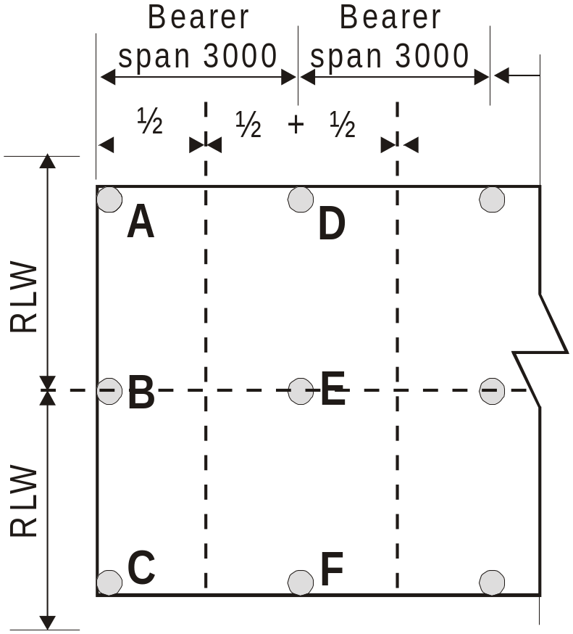
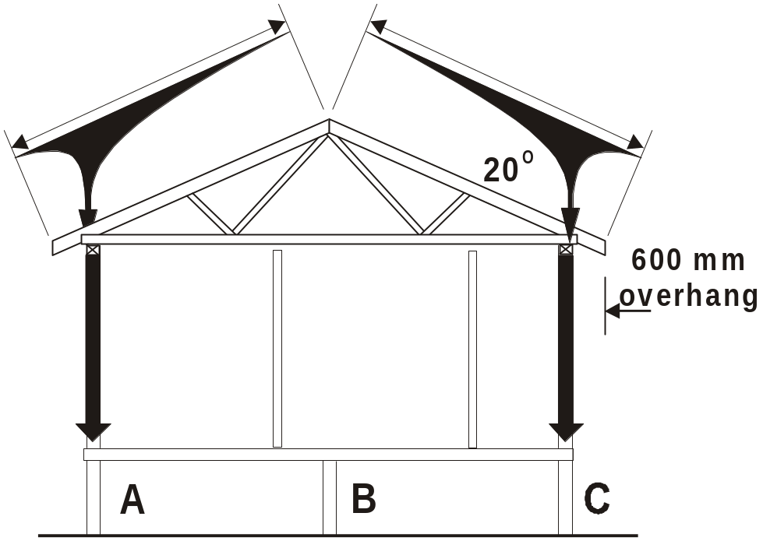
Trussed Roof - assuming no point loads from girder trusses etc., the roof loads will be evenly distributed to external walls and posts –

Slide 32
.....Roof load at
A = 4.47(RLW) x 1.5 = 6.70m² x 0.9 (tile roof) = 6.03kN
B = No load
C = 4.47(RLW) x 1.5 = 6.70m² x 0.9 (tile roof) = 6.03kN
D = 4.47(RLW) x 3.0 = 13.41m² x 0.9 (tile roof) = 12.07kN
E = No load
F = 4.47(RLW) x 3.0 = 13.41m² x 0.9 (tile roof) = 12.07kN

Slide 33
3.6.4 Determination of vertical gravity loads
3.6.4.3 Live loads (Q)
(a) Roof and floor live loads Roof live loads up to 0.25 kPa do not need to be included in the calculation of total vertical gravity loads.
Floor live loads (kN) shall be determined by multiplying the floor area (m²) supported by the individual stump, post, pier, or the like, under consideration by 1.5 kN/m².

Slide 34
(a) Roof and floor live loads (Cont)
The value of 1.5 kN/m² shall only apply to the general floor and deck areas of Class 1 buildings.
For decks greater than 1.0 m above the ground, the live load contributed by the area of deck under consideration shall be 3.0 kN/m² except for decks greater than 40 m² where the live load reduces to 1.5 kN/m².

Slide 35
EXAMPLE - FLOOR LIVE LOADS :
Using the areas supported as calculated for floor loads, the floor live load on the posts will be
A = 2.7m² x 1.5kN/m² = 4.05kN
B = 5.4m² x 1.5kN/m² = 8.10kN
C = 2.7m² x 1.5kN/m² = 4.05kN
D = 5.4m² x 1.5kN/m² = 8.10kN
E = 10.8m² x 1.5kN/m² = 16.2kN
F = 5.4m² x 1.5kN/m² = 8.10kN

Slide 36
3.6.4 Determination of vertical gravity loads
3.6.4.3 Live loads (Q)
(a) Other live loads
In alpine and sub-alpine areas, the contribution of snow loads exceeding 0.2 kPa, determined in accordance with AS 1170.4, shall also be added to the live loads.

Slide 37
3.6.5 Determination of total vertical gravity load combination for footings
The total vertical gravity load combination,
P (kN), shall be calculated as follows:
P = G + 0.5 Q
where
G = sum of individual permanent floor, wall and roof loads, in kilonewtons
Q = sum of individual floor (and snow if applicable) live loads, in kilonewtons
NOTE: The above load combination is derived from AS 2870.1.

Slide 38
For post at A -
Using the values calculated from the Dead and Live load examples :
G = 0.81 (floor load) + 1.08 (wall load) + 3.44 (Pitched Roof load) = 5.33kN
Q = 4.05 (floor live load) x 0.5 = 2.03kN
Total vertical gravity load at Post A
P = 5.33 + 2.03 = 7.36kN

Slide 39
For post at B -
Using the values calculated from the Dead and Live load examples :
G = 1.62 (floor load) + 2.16 (wall load) + 3.89 (Pitched Roof load) = 7.67kN
Q = 8.10 (floor live load) x 0.5 = 4.05kN
Total vertical gravity load at Post B
P = 7.67 + 4.05 = 11.72kN

Slide 40
For post at C -
Using the values calculated from the Dead and Live load examples :
G = 0.81 (floor load) + 1.08 (wall load) + 4.74 (Pitched Roof load) = 6.63kN
Q = 4.05 (floor live load) x 0.5 = 2.03kN
Total vertical gravity load at Post B
P = 6.63 + 4.05 = 8.66kN

Slide 41
For post at D -
Using the values calculated from the Dead and Live load examples :
G = 1.62 (floor load) + 2.16 (wall load) + 6.89 (Pitched Roof load) = 10.67kN
Q = 8.10 (floor live load) x 0.5 = 4.05kN
Total vertical gravity load at Post D
P = 10.67 + 4.05 = 14.72kN

Slide 42
For post at E -
Using the values calculated from the Dead and Live load examples :
G = 1.62 (floor load) + 2.16 (wall load) + 7.78 (Pitched Roof load) = 11.56kN
Q = 16.20 (floor live load) x 0.5 = 8.10kN
Total vertical gravity load at Post D
P = 11.56 + 8.10 = 19.66kN

Slide 43
For post at F -
Using the values calculated from the Dead and Live load examples :
G = 1.62 (floor load) + 2.16 (wall load) + 9.47 (Pitched Roof load) = 13.25kN
Q = 8.10 (floor live load) x 0.5 = 4.05kN
Total vertical gravity load at Post D
P = 11.25 + 4.05 = 17.30kN

Slide 44
3.6.6 Footing size or bearing area
The size of footing may be determined directly from Table 3.2 for the total vertical bearing load, P (kN), determined from Clause 3.6.5. Alternatively, the bearing area required for the footing, A (m²), may be determined as follows:
  A = P/100
NOTES:
1 The 100 kPa is the allowable bearing capacity of the foundation.
2 For worked examples, see Appendix E.

Slide 45
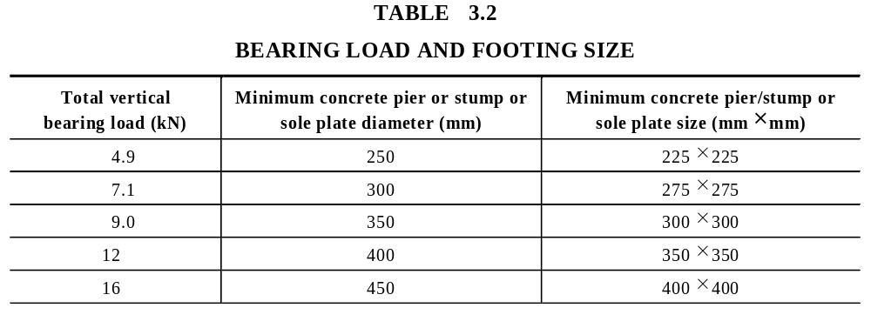

Slide 46
3.7 FOOTINGS AND SUPPORTS FOR WIND CLASSIFICATIONS N1 AND N2
3.7.1 General
This Clause deals with the selection of stumps and posts, and pad footings and sole plates, required to transfer roof, wall and floor loads to the soil foundation.

Slide 47
3.7.1 General
The bracing requirements of Section 8 shall be considered to ensure that the use of footing or post or stump details given in this Section are also adequate to resist lateral loads. For wind classifications greater than N2 (see Clause 3.6).

Slide 48
3.7.2 Simplified footing classification
For the purposes of this Clause, footings for stumps or posts are classified as types 1 to 5, as shown in Table 3.3. Footing types 1 to 4 are for use in areas where the allowable foundation bearing pressure is at least 100 kPa. Type 5 footings are only suitable where the allowable foundation bearing pressure equals or exceeds 125 kPa.

Slide 49
3.7.2 Simplified footing classification
Footings shall be proportioned to evenly distribute vertical and lateral loads from the building to the foundation material such that significant settlement or other movement is prevented.

Slide 50
3.7.2 Simplified footing classification (cont)
Timber soleplates shall not project beyond any face of the stump or post they support by more than their own thickness, taken across the grain, or three times their own thickness measured along the grain.
NOTE: Further information, including minimum depth requirements, is given in AS 2870.1.

Slide 51
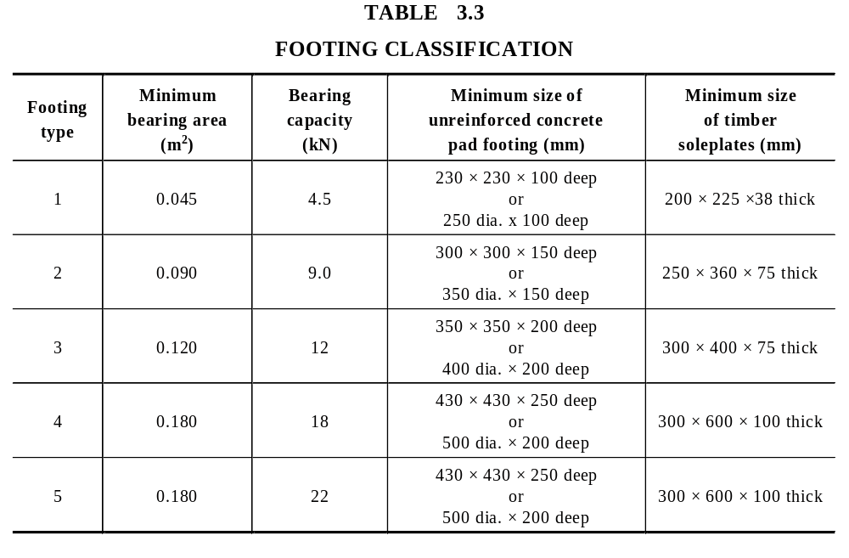
Nominal unseasoned
size of timber
soleplates (mm)
A4

Slide 52
3.7.3 Stumps and posts
(a) Sizes Stump and post sizes shall be appropriate to the footing type used, as shown in Table 3.4.
The use of stumps or posts in material other than timber shall be subject to the requirements of the relevant authority.

Slide 53
3.7.3 Stumps and posts (cont)
(b) Height The height above ground of any stump or post determined using Table 3.4 shall not exceed 15 times the minimum face width or diameter unless designed in accordance with recognized engineering principles.
NOTE: Where posts or stumps are designed in accordance with engineering principles, the height limitation may not apply.

Slide 54
3.7.3 Stumps and posts (cont)
(c) Embedment P37 AS1684.2 Stumps or post embedment in the foundation material shall be at least 0.3 times the stump height above ground level or 450 mm, whichever is the greater.

Slide 55
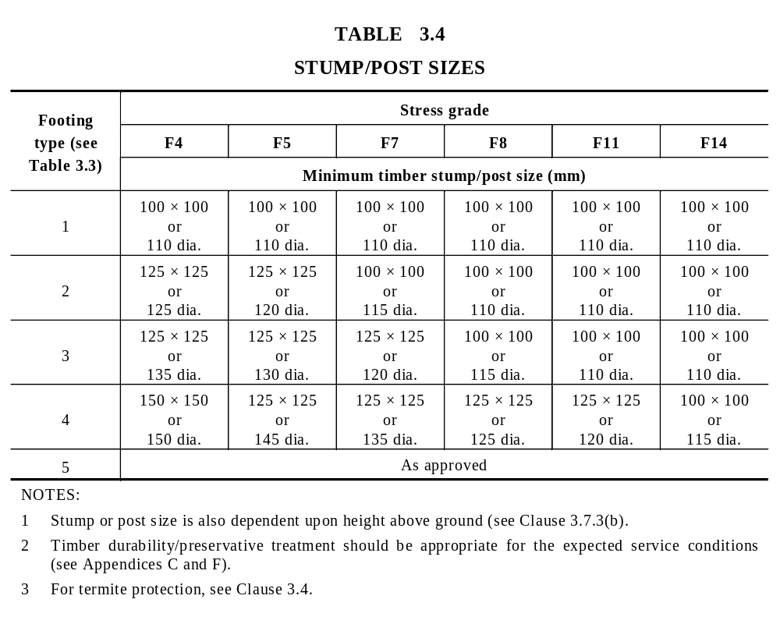
A4
Nominal unseasoned timber stump/post size (mm)

Slide 56
3.7.4 Footing type support limitations (load widths × bearer spans)
Tables 3.5, 3.6 and 3.7 give maximum permissible load widths and bearer spans for each footing type, based on footing capacity. The Span Tables give maximum bearer spans based on the capacity of the relevant timber cross-section. Both of these requirements shall be satisfied.

Slide 57
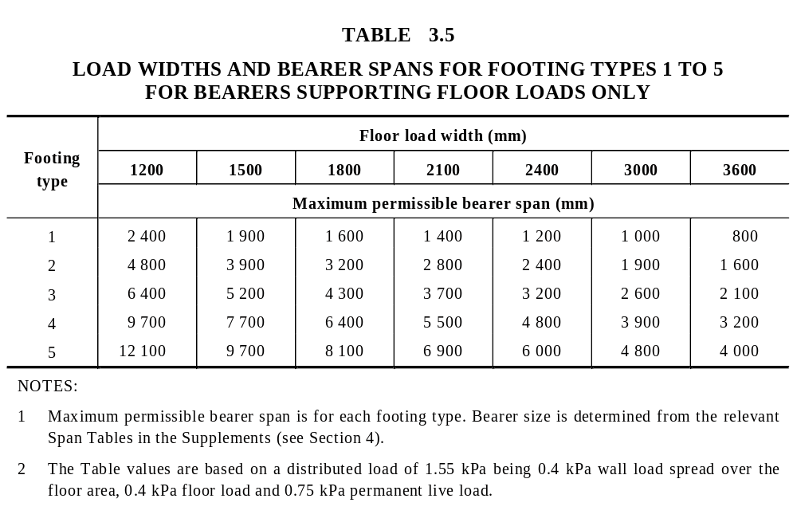

Slide 58
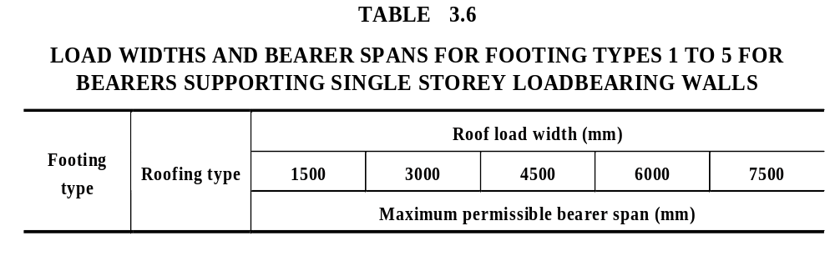
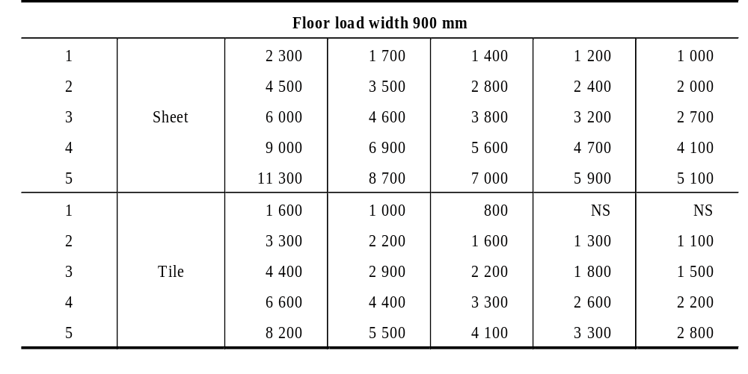

Slide 59
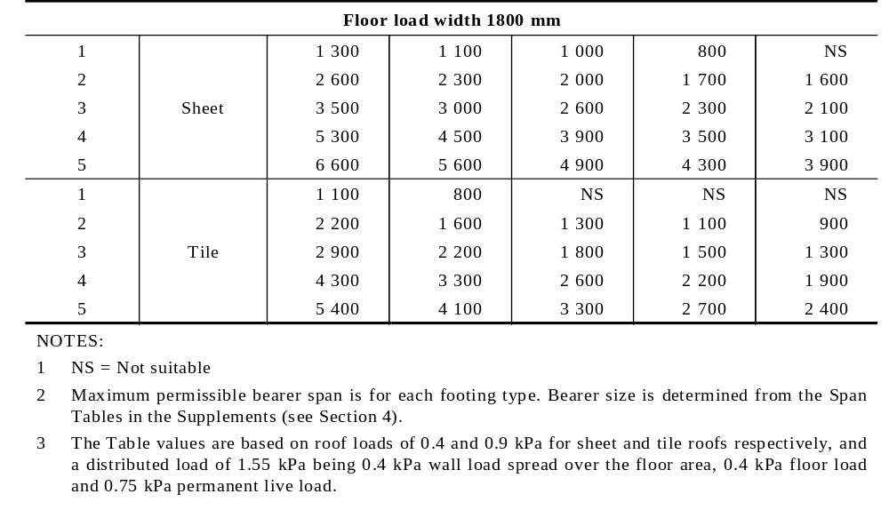
continued

Slide 60
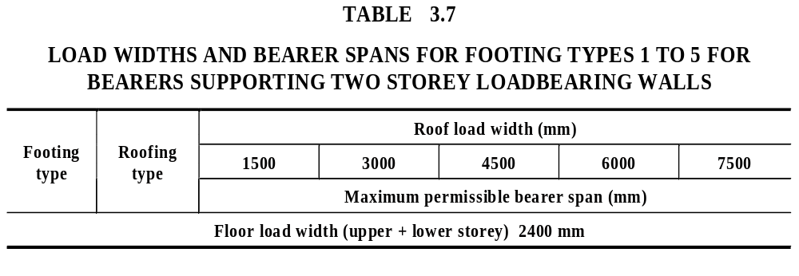
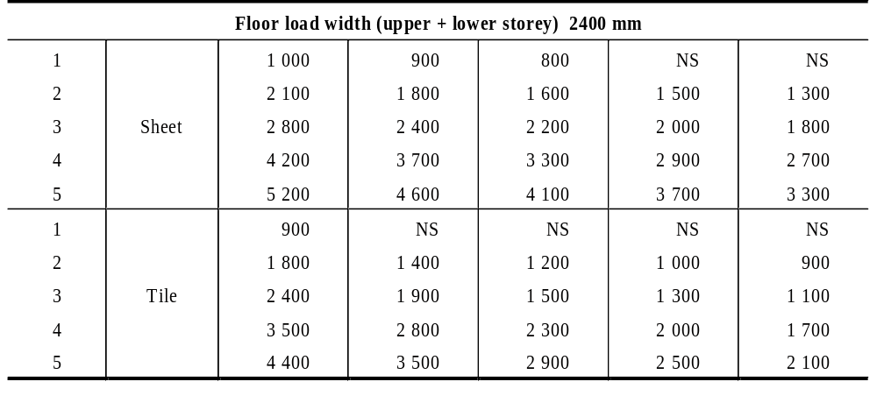

Slide 61
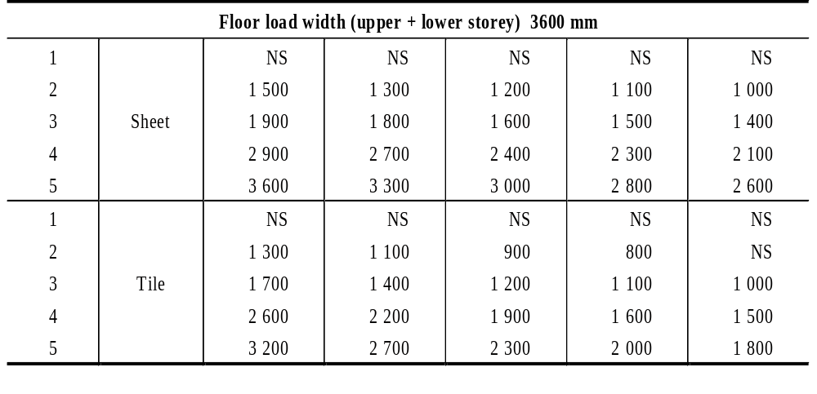
continued

Slide 62
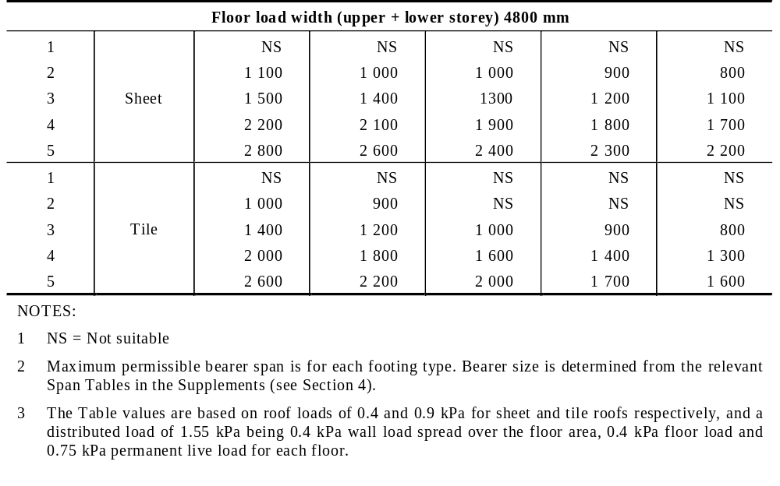
continued

